Slide 1
Textual, URL and File Summarization Using Bayesian Algorithm
Project Students:
R. PrithivRaj (420418205302)
k. SriKandhan (420418205303)
R.Tamizh Selvan (420418205304)
Project Guide:
Mr. M. Ezhilvendan B. Tech., ME..
Assistant professor,
Department of Information Technology,
Adhiparasakthi Engineering College

Slide 2
CONTENT
Abstract
Literature Survey
Existing System
Proposed System
Architecture Diagram
Algorithm and Techniques

Slide 3
Abstract :-
In this new period, where tremendous information is available on the internet, it is most important to provide the improved mechanism to extract the information quickly and most efficiently. It is very difficult for human beings to manually extract the summary of large documents of text. There are plenty of text materials available on the internet. So there is a problem of searching for relevant documents from the number of documents available, and absorbing relevant information from it. In order to solve the above two problems, the Textual, URL and File summarization is very much necessary. Textual, URL and file summarization is the process of identifying the most important meaningful information in a document or set of related documents and compressing them into a shorter version preserving its overall meanings.

Slide 4
Literature Survey
In recent years, there has been a explosion in the amount of text data from a variety of sources.
This volume of text is an invaluable source of information and knowledge which needs to be effectively summarized to be useful.
In this review, the main approaches to automatic text summarization are described.
We review the different processes for summarization and describe the effectiveness and shortcomings of the different methods.

Slide 5
Existing System :-
Existing systems include text summarizations.
It has traditionally been focused on text input.
Various methods for summarization were proposed which include extraction-based, abstraction-based, maximum entropy-based and aided summarization.
These methods use linguistic and natural language processing techniques.
Certain sentences that contribute to the summary might be omitted which in return might affect the generated summary.
Disadvantages:

Slide 6
Proposed System :-
Reading the large content of text available online is challenging for the users as it consumes a large amount of time.
The proposed system, Textual, URL and File Summarization is much more practical and summary of the input.
Extractive methods work by selecting a subset of existing words, phrases, or sentences in the original text to form the summary.
Time-saving process:
Computers are noticeably faster than humans and are capable of generating summaries faster
Automatic text summarization can be scaled to different languages with the adoption of a proper algorithm whereas humans are limited by the extent of their expertise in a particular language.
Advantages:

Slide 7
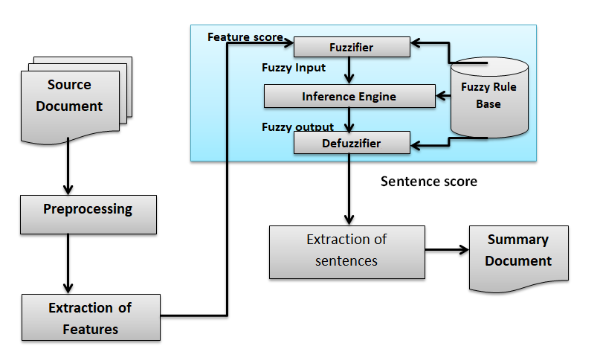
Architecture Diagram:-

Slide 8
Algorithm
Using Bayesian theorem. It can be used for collection of independent information in this prosses.
Techniques:
Selection:
Selection is an important summarization technique.
Rejection :
Rejection is an important summarization technique.
Substitution :
It is also an important summarization technique.

Slide 9


